Slide 1
Fence Patrol
Python with Robots Mission 5
Lesson 4 Objective 9

Slide 2

Pre-Mission Warm-Up
In your Mission 5 Lesson 4 log, answer the pre-mission warm-up questions:
What code will move the ‘bot forward?
What code will move the ‘bot backward?
What code will turn the ‘bot?

Slide 3
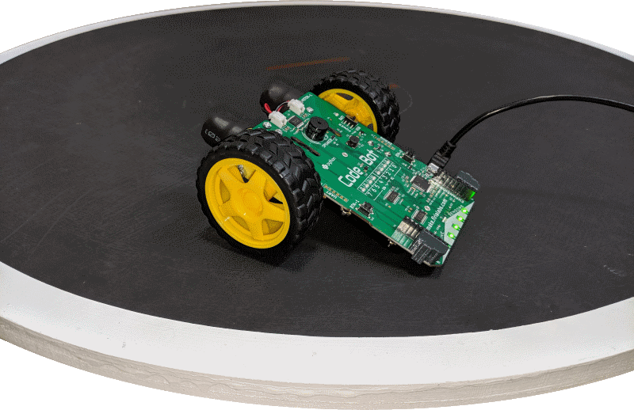
Mission 5: Fence Patrol
In this project, you will learn how to use data from CodeBot’s line sensors.
CodeBot has five line sensors mounted on the front of its board.
The sensors allow CodeBot to interact with its environment.

Slide 4
Mission 5: Fence Patrol
Project goals:
Read the line sensor and display the results on the green LEDs above them.
Use analog readings to measure the contrast between different surfaces.
Make a contact counter to show each line detect on the red User LEDs.
Teach CodeBot to drive between the lines!

Slide 5
Mission 5: Fence Patrol
For this lesson, we will complete the final task:
Teach CodeBot to drive between the lines!

Slide 6
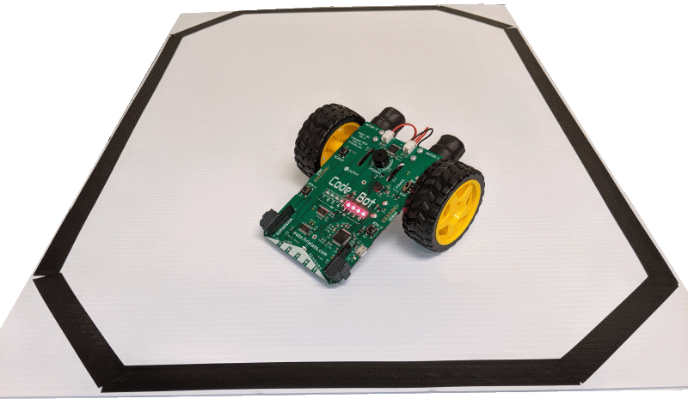
Objective #9: Fence Patrol v1.0
Ready to motor up?
Let’s design the algorithm for this project.
Remember: an algorithm is a step-by-step set of instructions a computer can follow to complete a task.

Slide 7
Objective #9: Fence Patrol v1.0
Here is the Fence Patrol algorithm:
Scan the line sensors.
If any sensor detects a black line, back up and turn.
Else, if no line is detected, drive forward.
Repeat forever.

Slide 8
Objective #9: Fence Patrol v1.0
Now you are ready to motor up!
You have designed your algorithm.
You have a “wait for button-press” safety feature.
And your sensor code has been fully tested.
All systems are go!

Slide 9
Objective #9: Fence Patrol v1.0
You need to define two more functions:
One for driving forward
One for backing up and turning
You already wrote similar code in Mission 4.
Let’s review the code.

Slide 10
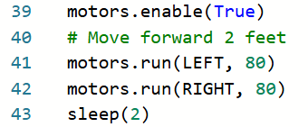
Objective #9: Fence Patrol v1.0
Open your code from Mission 4.
Animatronics
Review your code.
Look at the code segments that move the ‘bot forward

Slide 11
Objective #9 (Part 1) Activity
DO THIS:
Open your file – LineSense.
Define a new function for moving forward.
Call the function go_forward().
  You can select the speed for the motors.
  You do not need to enable the motors or sleep.

Slide 12
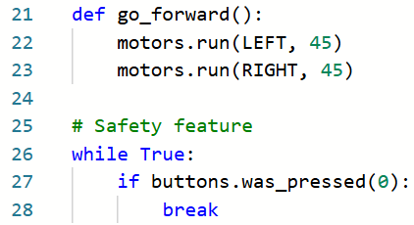
Objective #9 (Part 1) Activity
DO THIS:

Slide 13
Objective #9: Fence Patrol v1.0
You need another function for backing up and turning.
Think about the algorithm:
Back up (both motors same negative speed)
Sleep while backing up
Turn (motors with opposite speed)
Sleep while turning

Slide 14
Objective #9 (Part 2) Activity
DO THIS:
Define a new function for backing up and turning.
Call the function back_turn().
  You can select the speed for backing up.
  You can use the same or different speed for turning.
  You will need two sleep() commands.

Slide 15
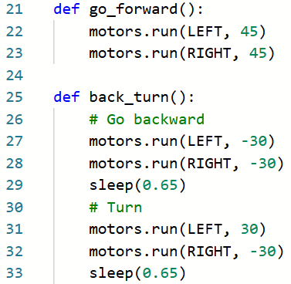
Objective #9 (Part 2) Activity
DO THIS:

Slide 16

Objective #9 (Part 2) Activity
DO THIS:
Test this function by calling it immediately after the “wait” safety feature.
Adjust the speed and sleep arguments until you have the backing up and turning just the way you want it.

Slide 17
Objective #9: Fence Patrol v1.0
Put it all together!
Call the two new driving functions in the main program loop.
If a line is “hit”, call back_turn()
Else, call go_forward()

Slide 18
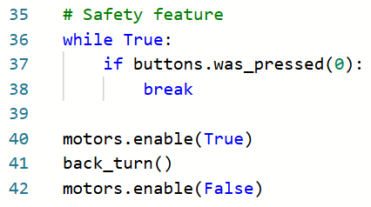
Objective #9 (Part 3) Activity
DO THIS:
Delete the test code for back_turn()

Slide 19
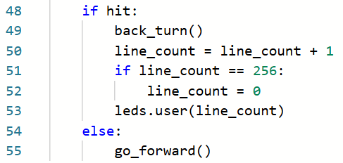
Objective #9 (Part 3) Activity
DO THIS:
Modify the main program loop to call the moving function.

Slide 20
Objective #9 (Part 3) Activity
DO THIS:
Run the program and test the ‘bot
on a white surface that has a black
line boundary.
Make any adjustments to your code for speed and sleep time.
Try your ‘bot with different shapes of boundaries.

Slide 21
Extensions
Here are some things to try:
Blink an LED while waiting for the BTN-0 press.
Play a tone when line_count is incremented.
Instead of sleeping when turning, play random beeps, similar to the animatronics program.
Add code for pressing BTN-1 to stop the program (break).
Program BTN-0 to test for a black line on a white surface, and BTN-1 to test for a white line on a dark surface.
Use random numbers for something: speed, sleep, pitch, etc.

Slide 22
Post-Mission Reflection
Complete the post-mission reflection in your Mission 5 Lesson 4 Log:
How do functions help manage the program code for the fence patrol?

